Slide 1
Kairos Inside:
More Than a Weekend

Slide 2
Welcome & Introductions
“Our Kairos Journey”
Roun McNeal
  Kairos Inside volunteer since 2010
  South Miss. Correctional Institute, Leakesville, MS (2010-2022)
  Marshall Co. Correctional Institute, Holly Springs, MS (2022-Present)
  Leader, MCCF Kairos #16
  Kairos of MS, Vice Chair
  Trainer for Kairos Inside Advanced Kairos Training
Jackie Greer
  Kairos Inside volunteer since 2015
  Mark Luttrell Correctional Center (MLCC), Memphis TN (2015-2016)
  Women’s Therapeutic Residential Center (WTRC), Henning TN (2016-Present)
  Leader, WTRC #5 & #19
  WTRC Advisory Council Chair 5 years
  Kairos of TN State Chapter, Recruiting Chair
  Trainer for Kairos Inside Advanced Kairos Training

Slide 3

Kairos Community Prayer
Jesus, come join us in our journey
As we seek Your will
For this community
In this environment.
Teach us to love each other
As You love us,
To give ourselves
As You give Yourself,
So that the Kingdom of God
Might be made present to all.
Amen

Slide 4

Devotion

Slide 5

Kairos Inside is More Than a Weekend
It’s a Journey
  Weekend
  Continuing Ministry
Three Pillars for Success in our Journey
  Continuing Ministry
  Volunteers with a Heart to Serve
  Proper Training
3 Day Weekend
Participant’s Doorway

Slide 6
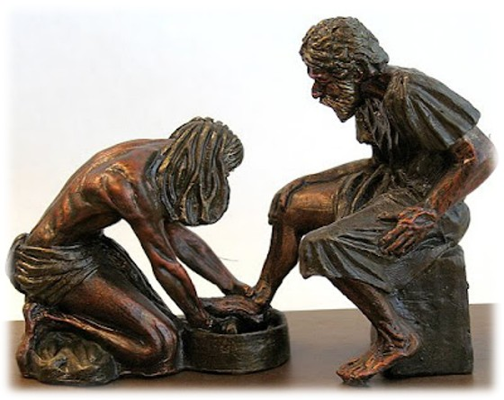
Success in our Journey
Volunteers with a Heart to Serve
  Remember who we serve
    Colossians 3:23
  Jesus modeled servanthood
    Matthew 23:11-12
Characteristics
  Serves selflessly, lovingly, humbly
    Matthew 7:12
  Gives without expecting anything in return
    1 John 4:21
  Meets the needs of others
    Matthew 25:35-40
  Serves to glorify God
    John 6:63
  Serves out of love for God
    1 Thessalonians 5:11

Slide 7
Success in our Journey
Proper Training
  Volunteers must be trained
    Learn Continuing Ministry
    Support Continuing Ministry
    Model Continuing Ministry
    Embrace Continuing Ministry
Proper Training
  Graduates must be trained
    Volunteers guide graduates toward Christ
    Volunteers teach Prayer and Share
    Volunteers prepare and support graduates

Slide 8
Success in our Journey
Proper Training
  Inside Resident Community Council
    Coordinate and run weekly Prayer and Share
    Promote Prayer and Share grouping
    Plan and run Monthly Reunions
  Prison Chaplain and Administration
    Memorandum of Understanding
    Kairos Inside Program Manual
    Chaplains Guide to Kairos Inside
    Inside Resident Council Handbook

Slide 9
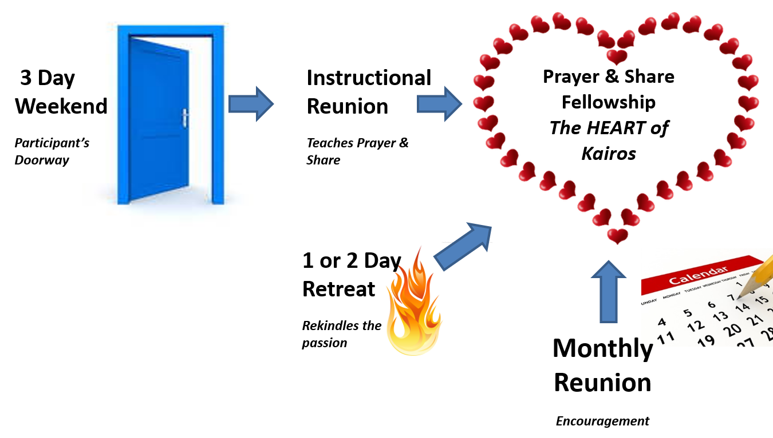
Journey through Continuing Ministry
Continuing Ministry How to and Why
Continuing Ministry has Four Parts
Plum Program Manual
  Pages 265 – 333
Continuing Ministry Video
  Download from mykairos.org
Continuing Ministry Zoom Training
  Register on mykairos.org

Slide 10

Instructional Reunion
Purpose
  Establish Christian community
  Teach and encourage Prayer and Share
  Teach spiritual listening
  Practice Prayer and Share
  Begin accountability
When
  Within 1-2 weeks of Weekend
Who
  Graduates & small group of volunteers from most recent Weekend
What
  Talk 1 – Spiritual Listening
    Prayer and Share instruction
  Five short talks from Prayer and Share grouping card
    Each followed by practicing Prayer and Share grouping
Instructional Reunion
Teaches Prayer & Share
Prayer & Share Fellowship
The HEART of Kairos

Slide 11
Prayer and Share
Prayer and Share
  Formal and Informal
  Powerful tool given to us by the Holy Spirit
  True heart of Kairos
  Christ is a permanent member of each group
Purpose
  Build Christian community & build accountability
  Teach vulnerability – trust God & others, intimacy with God & others
    Help develop deeper relationship with Christ
  Gain building blocks essential to growing their faith
    Prayer life, the Word, Fellowship
    Minister & serve others
    Christian character
  Connect to Kairos & others
    Part of a community, a family, and the Body of Christ
Prayer & Share Fellowship
The HEART of Kairos

Slide 12
Prayer and Share
Formal
  Structured groups, scheduled time
  Volunteers don’t sit with graduates
  Volunteers form their own group
  Volunteers listen, love, observe, help with logistics if needed
  No guest residents, only graduates
  Use Prayer and Share grouping card
Informal
  Graduates gather in their pods, yard, cafeteria, or other area
  No formal structure – still centered on prayer and accountability
  Two to six graduates grouping
  Use the Prayer and Share grouping card

Slide 13

Prayer and Share Grouping Card
Encourages openness & vulnerability
Creates space for support & understanding
Provides discipline & structure
Reinforces accountability & discipleship
Keeps focus on spiritual growth & nurturing one another – not on matters of the flesh

Slide 14
Journey through Continuing Ministry
Monthly Reunion
Reunion of residents, volunteers, & Christ
Celebrate Christ’s love, forgiveness, & renewal
Includes prayer, praise, fellowship, brief resident witness, & a grouping time
Grouping is not Prayer and Share
  One volunteer, six residents
  No Prayer and Share grouping card
  Focus on verse, topic, or study
  Fellowship & prayer, not accountability
Reunions are run by graduates
Volunteers who have not served on a Weekend can attend
Graduates may invite resident guests who have not attended a Weekend
Great recruiting tool
  See the Kairos community as a whole
  Could encourage guest volunteers & residents to attend a Weekend

Slide 15

Journey through Continuing Ministry
One-or-Two-Day Retreat
Kairos graduates attend
  Those active in Prayer and Share
  Those fallen away
  Get refreshed & restored
  Reconnect & recommit
Open to all Weekend Graduates
Small number of volunteers
Small group setting
  1 volunteer 6 graduates
Theme for the Day

Slide 16
Journey to Transformation
Continuing ministry – when conducted as intended will help maintain a transformative presence within a facility that truly changes lives
Transformation Impacts
  Residents
  Volunteers
  Chaplain & Staff

Slide 17
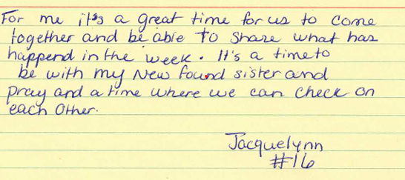
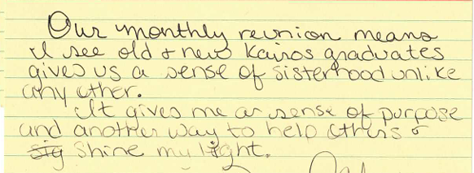
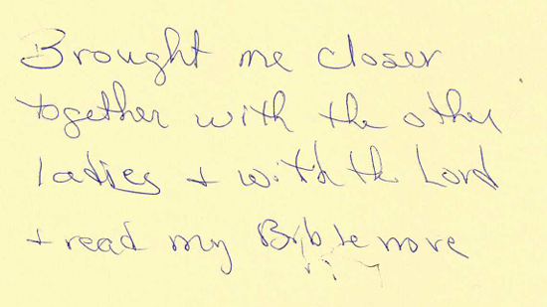
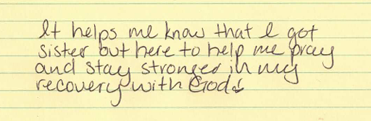
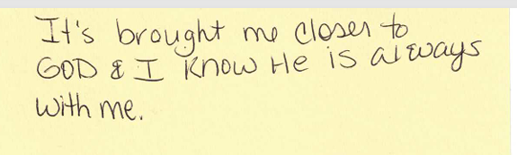
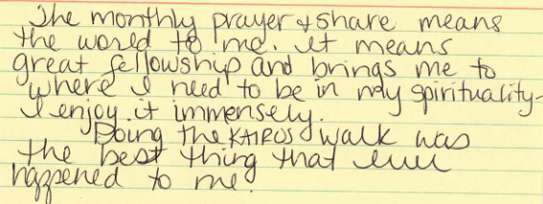


Slide 18
“An Amazing Reflection of How Kairos Changed a Chaplain’s View on Prison Ministry”
Mykairos.org
Reverend Bob Reed
“As I type my reflections, I have come away convinced that Kairos is one of the most impacting outreaches to the incarcerated that I have ever observed. All of the elements that are included in the Weekend and through the program, give the possibility of creating an authentic Christian community for inmates while they are still inside.”

Slide 19


Thank you
Praise and Polish
  Please complete your evaluation feedback form
Questions

